Slide 1
Car Accident Forecasting
Forecasting car accidents by analyzing their relationships with weather conditions, time of day, and population
Gregory Happ

Slide 2
The Datasets
US-Accidents: A Countrywide Traffic Accident Dataset
https://smoosavi.org/datasets/us_accidents
Census Data
https://blog.splitwise.com/2013/09/18/the-2010-us-census-population-by-zip-code-totally-free/amp/

Slide 3
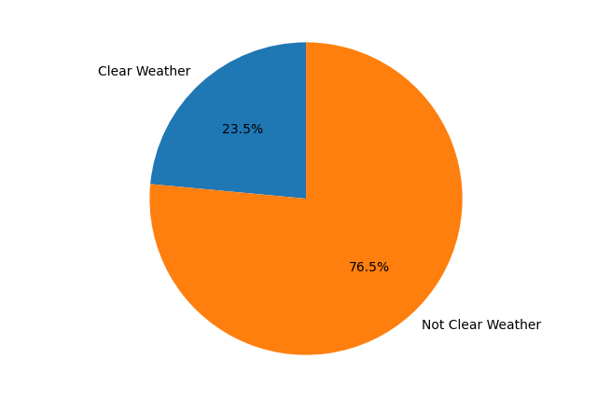
Weather Conditions

Slide 4
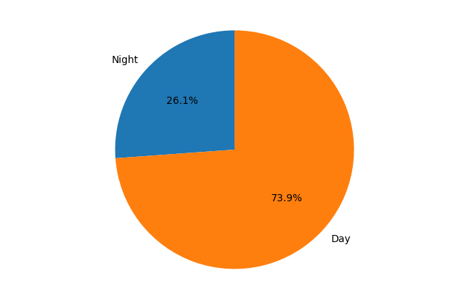
Day or Night

Slide 5
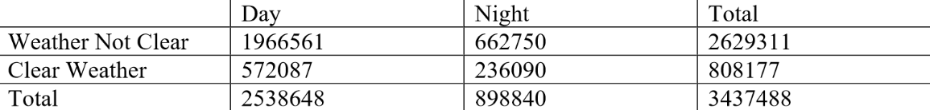
Weather Conditions and Time

Slide 6
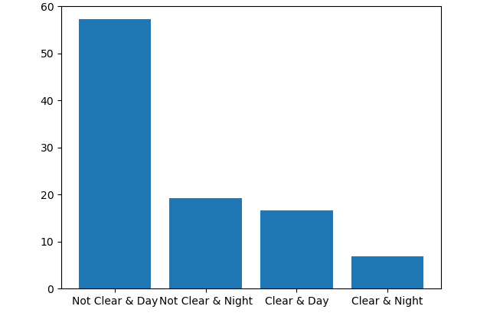
Weather Conditions and Time

Slide 7
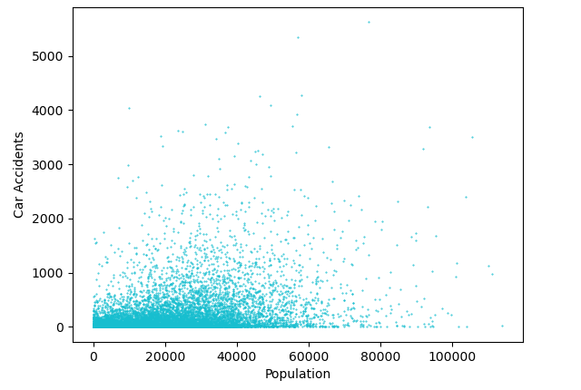
Population

Slide 8

Population

Slide 9
Correlation: Population and Car Accidents
Pearson's r = 0.4278201964372337
p-value = 0.0
Spearman's rho = 0.5770351900548639
p-value = 0.0
Kendall's tau = 0.4071861941576106
p-value = 0.0

Slide 10
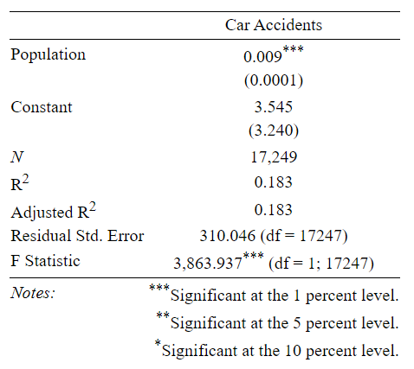
OLS: Population and Car Accidents

Slide 11
Summary
There is evidence that suggests that weather conditions, time of day, and population could be used to forecast the total amount of car accidents for a given area during a given time period.

Slide 12
Acknowledgments
Python and R were used for coding the project
Python Packages: pandas, matplotlib, scipy, sklearn
McKinney, W., & others. (2010). Data structures for statistical computing in python. In Proceedings of the 9th Python in Science Conference (Vol. 445, pp. 51–56).
Hunter, J. D. (2007). Matplotlib: A 2D graphics environment. Computing in Science &amp; Engineering, 9(3), 90–95.
Virtanen, P., Gommers, R., Oliphant, Travis E., Haberland, M., Reddy, T., Cournapeau, D., … Contributors, SciPy 1. 0. (2020). SciPy 1.0: Fundamental Algorithms for Scientific Computing in Python. Nature Methods.
Scikit-learn: Machine Learning in Python, Pedregosa et al., JMLR 12, pp. 2825-2830, 2011.
R Packages: stargazer, dplyr
Hlavac, Marek (2018). stargazer: Well-Formatted Regression and Summary StatisticsTables. R package version 5.2.2. https://CRAN.R-project.org/package=stargazer
Hadley Wickham, Romain François, Lionel Henry and Kirill Müller (2018). dplyr: A Grammar of Data Manipulation. R package version 0.7.6. https://CRAN.R-project.org/package=dplyr
1st Dataset:
https://smoosavi.org/datasets/us_accidents
Moosavi, Sobhan, Mohammad Hossein Samavatian, Srinivasan Parthasarathy, and Rajiv Ramnath. “A Countrywide Traffic Accident Dataset.”, arXiv preprint arXiv:1906.05409 (2019).
Moosavi, Sobhan, Mohammad Hossein Samavatian, Srinivasan Parthasarathy, Radu Teodorescu, and Rajiv Ramnath. “Accident Risk Prediction based on Heterogeneous Sparse Data: New Dataset and Insights.” In proceedings of the 27th ACM SIGSPATIAL International Conference on Advances in Geographic Information Systems, ACM, 2019.
2nd Dataset:
https://blog.splitwise.com/2013/09/18/the-2010-us-census-population-by-zip-code-totally-free/amp/
Jon Bittner, The Splitwise Blog Contributor

